Slide 1
Week 7 - Macroeconomics

Slide 2
Unit 3
We have talked about GDP, Unemployment and Inflation in Unit 2.
We will now look at the graphical representation of these indicators in Unit 3.

Slide 3
Aggregate Demand
We will start Unit 3 with the idea of Aggregate Demand, which builds on our knowledge of demand on a micro level.

Slide 4

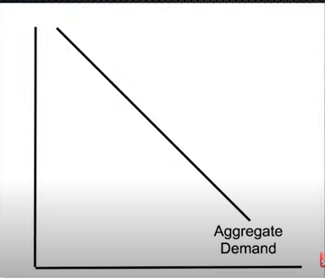

Aggregate Demand
Link
Summary
Aggregate = total
Aggregate Demand = Demand for ALL Goods and Services in the Economy
What is aggregate demand?
Aggregate = total, the whole economy
Demand = Demand
  demand for any one good/service is how much consumers want to buy at a given price.
Therefore, Aggregate demand simply takes the demand for ALL G&S in the economy at different price levels.
  Aggregate Demand follows the law of demand, just like demand for one good

Slide 5
Review – Circular Flow
We can more easily understand aggregate demand by revisiting the circular flow model.

Slide 6
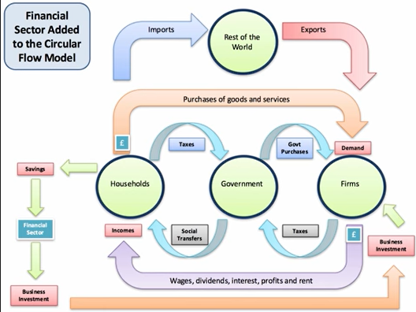
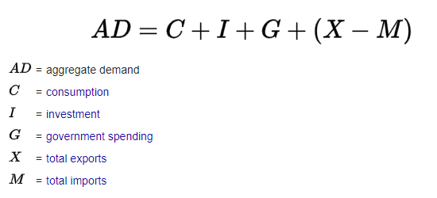
Total Expenditure
The expenditure method of calculating GDP is given by the spending of:
Households
Firms
Government
Foreigners
Consumption, C
Investment, I
Government Spending, G
Exports – Imports, (X-M)
GDP = C + I + G + (X-M)
GDP
Note: We don’t count businesses buying from households because that is essentially a trade between households and businesses (factors of production for goods) and so we only need to count one of them.

Slide 7
Revision - Circular Flow
Exports – Imports (X-M)
GDP = C + I + G + (X-M)
Consumption (C )
Government Spending (G)
Investment (I)

Slide 8
Aggregate Demand and GDP
Link
Aggregate = total, the whole economy
Demand = demand
GDP measures everything that is produced AND purchased, therefore Aggregate Demand (AD) is the same as our output.
So the method of calculating AD is the same as the expenditure method of calculating GDP.
Aggregate Demand (AD) = C+I+G+(X-M) (from our circular flow model)
Because these simply represent the spending of the different ‘entities’ in the economy.
GDP = AD = C + I + G + (X-M)
Summary: Aggregate Demand = Demand for ALL Goods and Services in the Economy, taken from our circular flow model

Slide 9
What are the components of aggregate demand?
Consumer spending (C)
Investment Spending (I)
Government expenditure (G)
Net exports (X-M)
GDP = AD = C + I + G + (X-M)
Aggregate Demand = Demand for ALL Goods and Services in the Economy, taken from our circular flow model
Note: A more mathematically correct way of viewing AD is a function, which will vary with the price level.

Slide 10
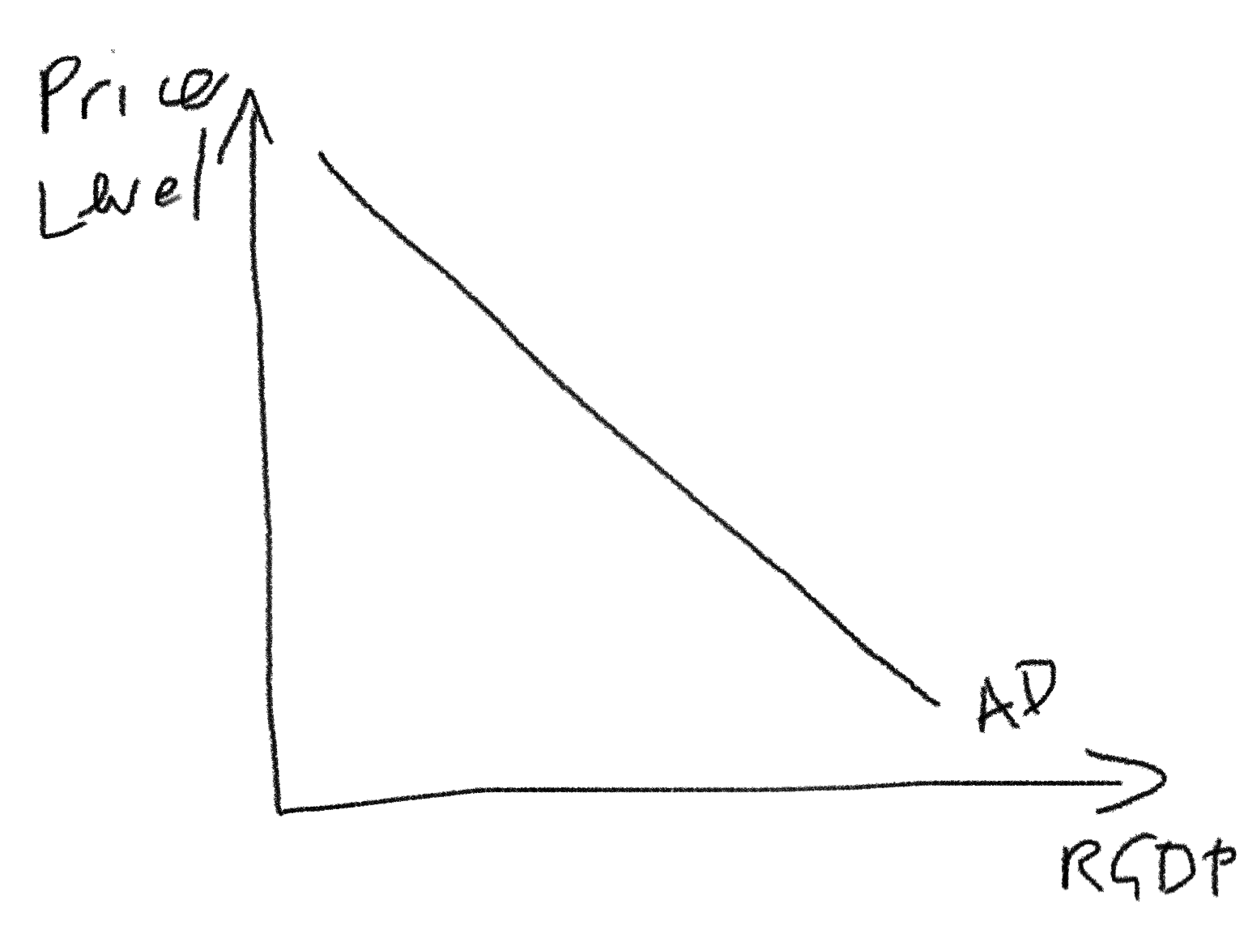
Differences between AD and regular Demand
Price level because it’s all goods and services in the economy.
China’s Economy
The AD curve is similar to the Demand curve we saw in Unit 1 but we must make some changes.
This is because, compared to the ‘micro demand curve’ the AD curve represents the whole economy.
 | Micro Demand Curve | Macro Demand Curve (AD)
Y axis, X axis
Price, Quantity
Price Level, Quantity of all goods produced = Real GDP = RGDP
RGDP because it’s the quantity of ALL G&S in the economy
Note:
You can also use:
RGDP, Y, Real Output
Name
Market for Chocolate
China (Market for all G&S in China)

Slide 11
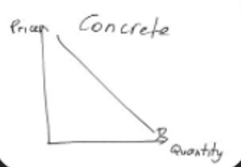
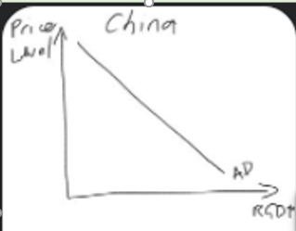
Draw a regular demand curve (eg. market for concrete) with correctly labeled axes.
Graph the AD function with the correctly labeled axes.

Slide 12
What are some alternate labels for Real GDP?
Real Output
RGDP
Real Income (remember the income method for measuring GDP)
Y

Slide 13
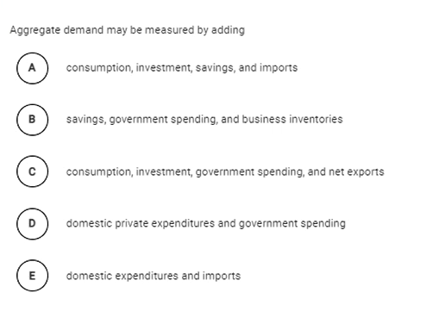
Answer: C

Slide 14

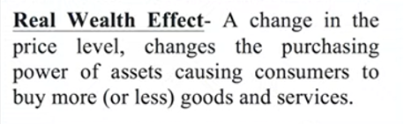

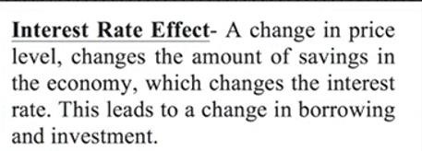


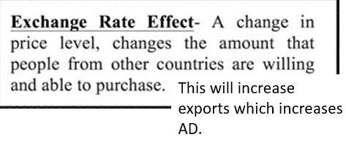

Why the AD curve slopes down
Note: This wealth effect is the main reason and the other two are minor reasons.
AD follows the law of demand; it is downward sloping.
We should learn the three reasons that explain its slope (just as we did for the micro demand curve).
Real Wealth Effect – A change in the price level, changes the purchasing power of assets causing consumers to buy more (or less) goods and services.
Interest Rate Effect – A change in the price level, changes the amount of savings in the economy, which changes the interest rate. This leads to a change in borrowing and investment which will increase/decrease the AD.
Net Export/Foreign Trade Effect – A change in the price level, changes the amount that foreigners will purchase from our country which will affect the AD.

Slide 15


Real Wealth Effect
You have $100,000 dollars in the bank
You also earn $5000 per month.
The price level decreases.
What happens to the value of your income and your savings?
  Increases
Will you spend more or less?
  Therefore firms and households will spend more
Expenditure
(Consumption, Investment)
Summary
Real wealth effect – wealth increases which causes people and businesses to spend more, increasing GDP.
Real GDP

Slide 16

Foreign Trade Effect
The price level decreases.
This makes goods in that country relatively cheaper, but also for foreigners, especially if the price level is higher in their countries.
Foreigners will therefore purchase more from our country, increasing exports.
Locals will also import less from other countries.
More Expenditure
  More Exports
  Fewer imports
Real GDP
Summary
Foreign Trade Effect– lower price levels lead to relatively cheaper prices in your country -> increased exports, decreased imports

Slide 17



Interest Rate Effect
This will be explained again in Unit 4.
The lower price level lets people save more.
The price level decreases.
Not only will you be able to spend more (Wealth Effect) but you will also be able to save more.
When people save more, the banks have more money available to lend out. The interest rate will fall. (We will see in Unit 4 why this is true.)
Because the interest rate is lower people can now borrow money more cheaply.
  People will borrow AND spend more
    This applies to ‘interest sensitive goods’ such as cars, houses, machinery which is often too expensive to buy immediately without borrowing money.
More savings leads to a lower interest rate
People can borrow more
More Expenditure
  (Consumption, Investment)
Summary
The lower price level causes a lower interest rate so people borrow and spend more.
Interest Rate Effect: increased real wealth -> increased savings -> decreased interest rate -> increased borrowing -> increased interest sensitive expenditure
Real GDP

Slide 18
Identify two effects that result in a downward sloping aggregate demand curve.
The real wealth effect – low prices means you can afford to buy more with your current wealth, increasing spending.
The net exports effect – low prices means that foreigners will purchase more goods which increases exports and increases output.
The interest effect – low prices means people can afford to save more money, which makes borrowing cheaper, increases interest sensitive expenditure, increasing output.

Slide 19
Aggregate Demand (AD) Shifts
Just like the micro demand curve, AD can shift due to many different factors.
Rightward Shift
  This means that people all through the economy want to buy more G&S at the same price level (measured in dollars, RMB, pounds etc.)
Leftward Shift
  This means that people all through the economy want to buy less G&S at the same price level (measured in dollars, RMB, pounds etc.)
  This has important consequences for the entire economy!

Slide 20
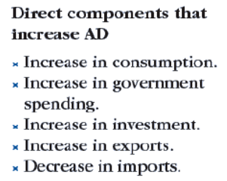
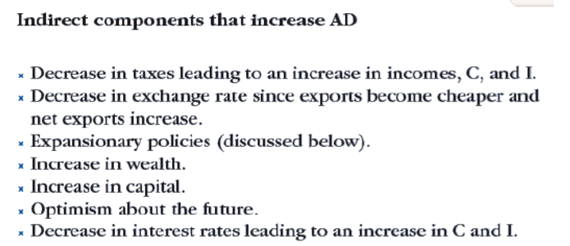
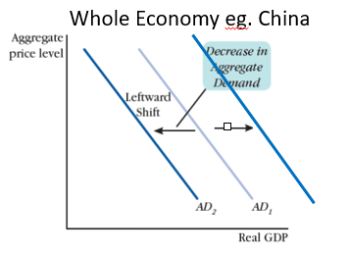
Factors that Shift Aggregate Demand
Summary
An aggregate demand shock is change in any factor that affects C,I,G,X-M
Events that shift the demand curve can be referred to as demand shocks.
Direct Components that shift AD
∆Consumption
∆Investment
∆Government Spending
∆Exports
∆Imports
Indirect Components that shift AD
∆Tax rates
∆Exchange Rate
∆Government policies (to be discussed further)
∆Wealth
∆Technology
∆Optimism/confidence
∆Price level of other countries compared to ours
Etc.
The indirect components are factors that would cause households, government, business and rest of world to to buy more or less.
Instead of memorizing the whole list, think intuitively about what effect the change in some factor would have.

Slide 21
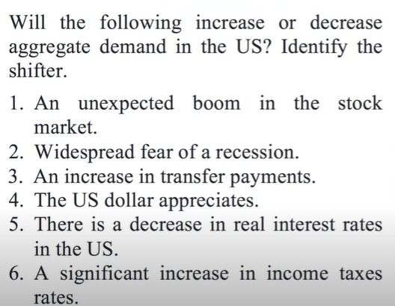
1. Wealth increases therefore ↑C ↑AD
2. ↓Confidence -> ↓C ↓I-> ↓AD
3. Poor people spend larger proportion of income, therefore ↑C ↑AD
4. ↑M ↓X -> ↓AD
5. Lower cost of borrowing will increase ‘interest sensitive consumption’ ↑C ↑AD
6. ↓C↓AD

Slide 22
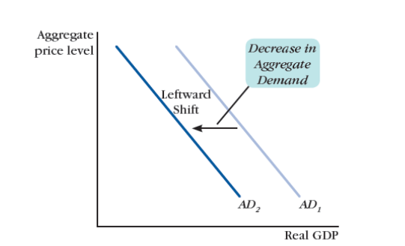
Movement Along vs Movement of Curve
Whole Economy eg. China
Whole Economy eg. China
Increase and Decrease in AD
Change in other factors (that aren’t price level)
  Change in business confidence
  Change in population
  Change in wealth
  Change in net exports
  Etc.
Change in price level
Summary
Movement along – change in price level
Shift of AD curve – change in other factors
Right – ‘increase in AD’
Left – ‘decrease in AD’

Slide 23

Demand Shocks – What will be the effect on AD?
Factor | Increase | Decrease
Stock market stocks owned by households | ↑AD – consumers are wealthier now | ↓AD – consumers are poorer now
Government purchases | ↑AD – increase government spending | ↓AD – decrease gov spending
Consumer Confidence | ↑AD – consumers will buy more in the future | ↓AD – consumers will buy less
Unemployment | ↓AD – people have less income | ↑AD – people have more income
Technology of Products | ↑AD – consumers are attracted by new products | ↓AD – consumers get less utility from products
Inventory levels and Capital Goods levels | ↓AD – businesses don’t need to invest as much in new inventory | ↑AD – businesses need to buy a lot of new inventory
Price level of another country | ↑AD – foreigners will purchase more of our exports | ↓AD – foreigners will purchase less of our exports

Slide 24
Demand Shocks – What will be the effect on AD?
Factor | Increase | Decrease
Stock market stocks owned by households | ↑AD – consumers are wealthier now | ↓AD – consumers are poorer now
Government purchases | ↑AD – increase government spending | ↓AD – decrease gov spending
Consumer Confidence | ↑AD – consumers will buy more in the future | ↓AD – consumers will buy less
Unemployment | ↓AD – people have less income | ↑AD – people have more income
Technology of Products | ↑AD – consumers are attracted by new products | ↓AD – consumers get less utility from products
Inventory levels and Capital Goods levels | ↓AD – businesses don’t need to invest as much in new inventory | ↑AD – businesses need to buy a lot of new inventory
Price level of another country | ↑AD – foreigners will purchase more of our exports | ↓AD – foreigners will purchase less of our exports
Wealth of neighboring countries | ↑AD – foreigners will purchase more of our exports | ↓AD – foreigners will purchase less of our exports

Slide 25

Answer:
A – shift to the left (Note: we will cover monetary policy in Unit 3 and 4)
B – movement along caused by change in price level
C – shift to the left
D – shift to the right
E – movement along caused by change in price level
F - shift to the right
Note: For a shift of the curve right and left we can say an increase and decrease in AD.

Slide 26
List four indirect factors that cause a shift in the AD curve.
Increase/decrease in taxes
Optimism about the future
How much physical capital was produced in previous years (if a business has enough inventory/capital then they won’t buy more)
Expectations of price level increases/decreases

Slide 27
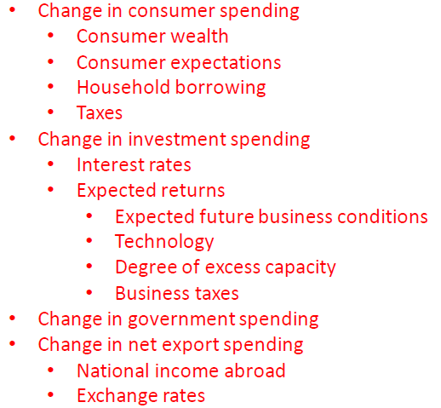
Complete Answer
Aggregate Demand Shocks
C
Whole Economy eg. China
I
G
X-M

Slide 28
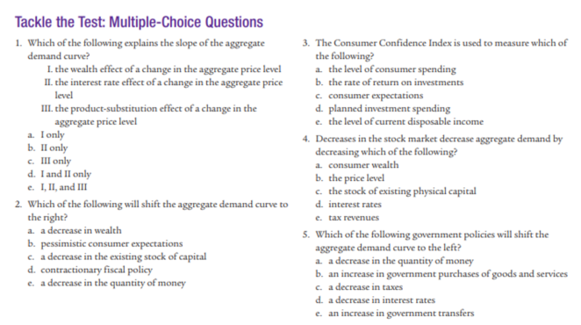
Module 17
Answer: C
(A. is not as correct because people could be spending out of panic for example.
Answer: D
(III is incorrect because AD looks at ALL goods so there can be NO substitution effect because we assume all prices have increased.)
Answer: A
Less consumer wealth will make people spend less (on normal goods)
Answer: C
Less capital means that businesses will need to buy more capital which will increase Investment (I)
Answer: A
We will learn more about this more in Unit 4 and 5.

Slide 29
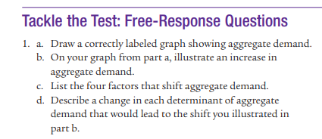
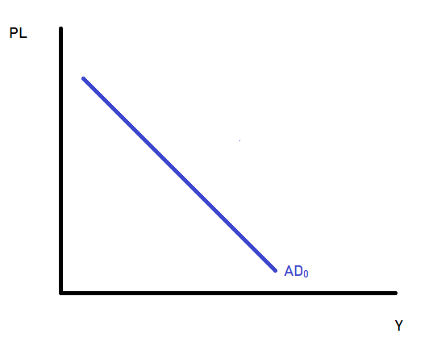
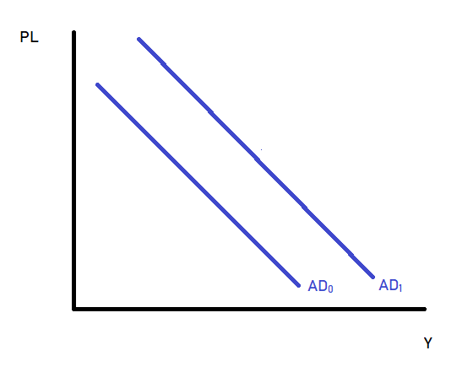
c)
Increase C (Consumption)
Increase I (Investment)
Increase G (Government spending)
Increase (X-M) (Net Exports)
d)
C: increase in wealth, increase in consumer confidence, better quality goods
I: – improved technology, more capital needs to be replaced
G: – more public projects, increased social welfare
(X-M): foreigners more wealthy, exports quality improves
a)
b)

Slide 30
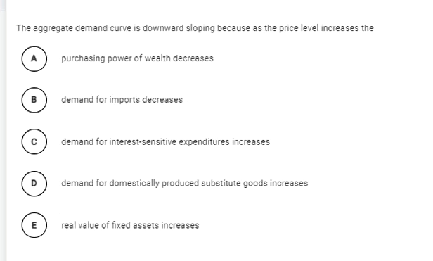
Answer: A

Slide 31
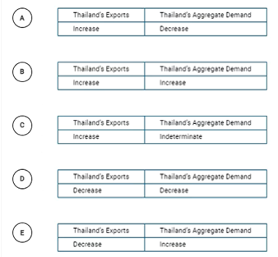
Thailand and Malaysia are trading partners. If the price level in Thailand decreases relative to the price level in Malaysia, what will happen to Thailand exports to Malaysia and Thailand’s aggregate demand?
Answer: B
Thailand’s exports will increase because they are more affordable for foreigners
↑X→ ↑AD

Slide 32
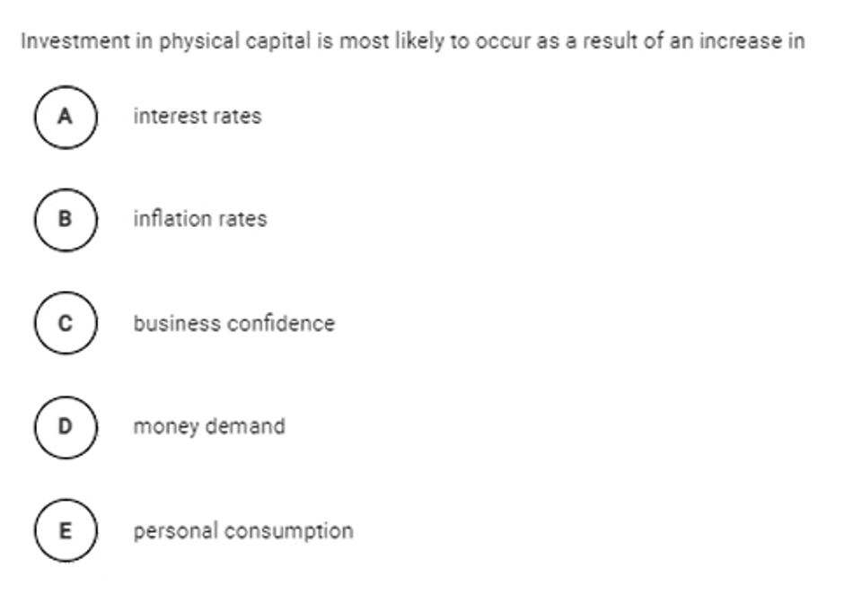
Answer: C

Slide 33
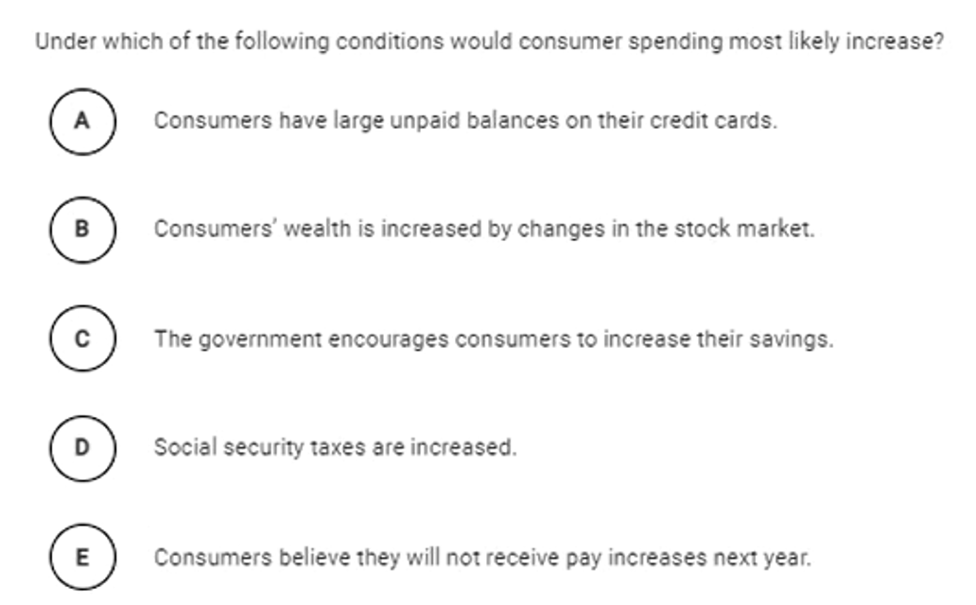
Answer:
B

Slide 34
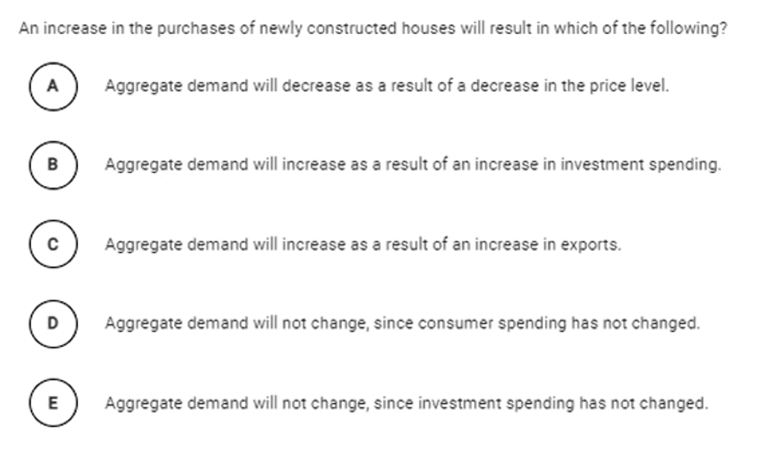
Answer:
B
It would also increase consumption of households but this is not an option.

Slide 35
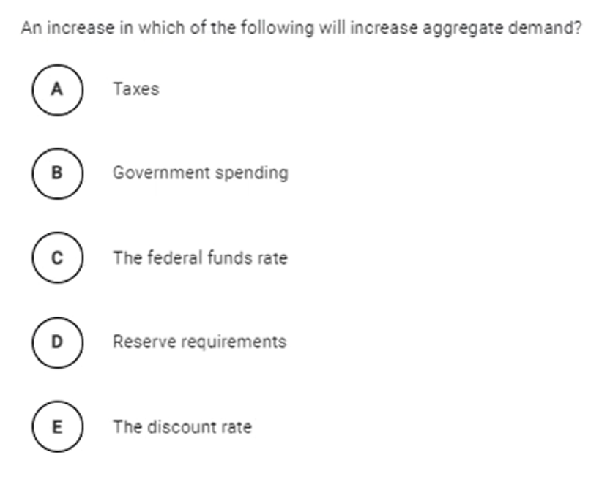
Answer:
B

Slide 36
AD, Aggregate Demand Summary

Slide 37
Aggregate Demand and GDP
Link
Aggregate = total, the whole economy
Demand = demand
GDP measures everything that is produced AND purchased, therefore Aggregate Demand (AD) is the same as our output.
So the method of calculating AD is the same as the expenditure method of calculating GDP.
Aggregate Demand (AD) = C+I+G+(X-M) (from our circular flow model)
Because these simply represent the spending of the different ‘entities’ in the economy.
GDP = AD = C + I + G + (X-M)
Aggregate Demand = Demand for ALL Goods and Services in the Economy, taken from our circular flow model

Slide 38
Differences between AD and regular Demand
Price level because it’s all goods and services in the economy.
China’s Economy
AD is very central to AP Macro, therefore it is important to be able to graph it correctly.
We have to make minor changes to the AD curve because we are examining the whole economy!
 | Micro Demand Curve | Macro Demand Curve (AD)
Y axis, X axis
Price, Quantity
Price Level, Quantity of all goods produced = Real GDP = RGDP
RGDP because it’s the quantity of ALL G&S in the economy
Note:
You can also use:
RGDP, Y, Real Output
Name
Market for Chocolate
China (Market for all G&S in China)

Slide 39
Why the AD curve slopes down
Note: This is the main reason and the other two are minor reasons.
AD follows the law of demand; it is downward sloping.
We should learn the three reasons that explain its slope (just as we did for the micro demand curve).

Slide 40
Movement Along vs Movement of Curve
Whole Economy eg. China
Whole Economy eg. China
Change in other factors (that aren’t price level)
  Change in business confidence
  Change in population
  Change in wealth
  Etc.
Change in price level

Slide 41
Demand Shocks – What will be the effect on AD?
Factor | Increase | Decrease
Stock market stocks owned by households | ↑AD – consumers are wealthier now | ↓AD – consumers are poorer now
Government purchases | ↑AD – increase government spending | ↓AD – decrease gov spending
Consumer Confidence | ↑AD – consumers will buy more in the future | ↓AD – consumers will buy less
Unemployment | ↓AD – people have less income | ↑AD – people have more income
Technology of Products | ↑AD – consumers are attracted by new products | ↓AD – consumers get less utility from products
Inventory levels and Capital Goods levels | ↓AD – businesses don’t need to invest as much in new inventory | ↑AD – businesses need to buy a lot of new inventory
Price level of another country | ↑AD – foreigners will purchase more of our exports | ↓AD – foreigners will purchase less of our exports

Slide 42
Aggregate Supply
So far we have looked at expenditure in the economy only through Aggregate Demand.
However, in order for the economy to consume, the economy must produce!

Slide 43


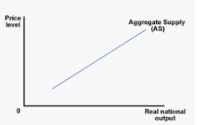




Aggregate Demand
Short Run Aggregate Supply (SRAS)
Aggregate Supply

Slide 44
Aggregate Supply
Summary
AD – total expenditure in the economy
AS – Aggregate Supply – total production in the economy.
Demand refers to people or groups in society who wish to buy goods and services.
Supply is about production. The supply curve represents producers’ willingness/ability to sell.
Just like with AD, the AS takes the markets for individual goods and services to and creates a single function that represents all the goods and services produced in the economy.
Just like with AD, the axes are slightly different.
Price -> Price Level (because price of all products)
Quantity -> Real GDP (because quantity produced of all goods is our GDP)

Slide 45
What is aggregate demand (AD)?
A function that puts demand for all goods and services in the economy into a single function.
What is aggregate supply (AS)?
A function that shows the ability to produce all goods and services in the economy into a single function.

Slide 46
Name Change! - Short Run Aggregate Supply
The full name for our upward sloping AS curve is actually Short Run Aggregate Supply - SRAS
The short run refers to a shorter period of time than the long run.
  More precisely, it is where certain factors are considered fixed.
Therefore our SRAS shows the short term level of supply in the economy.
Note: We will cover this in more detail shortly which will explain why we are giving the curve this ‘unnecessary name’.
SRAS
Summary
This AS curve is actually called the SRAS because it represents the short run condition in the economy.

Slide 47
Aggregate Demand
Short Run Aggregate Supply (SRAS)
Short Run Aggregate Supply

Slide 48
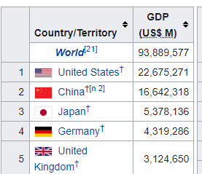


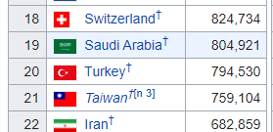

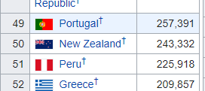


The Size of Different Economy’s Aggregate Supply Curves
Draw the aggregate supply curves of a small economy country eg. New Zealand, medium sized country eg. Turkey and a large country eg. China.
New Zealand
Turkey
China
Note: We are assuming the same price level in each country which isn’t necessarily true.
0.24 trillion
USD
0.79 trillion
USD
16.6 trillion
USD

Slide 49
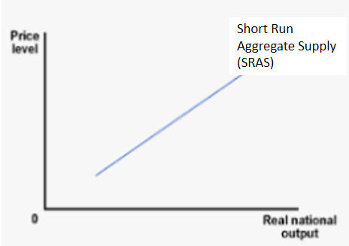
Graphing Activity
Draw the SRAS

Slide 50
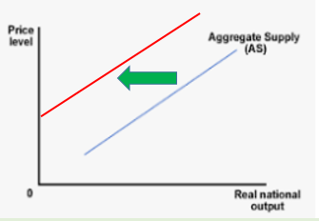
Movement Along Curve vs Movement of Curve
Short Run Aggregate Supply (SRAS)
Short Run Aggregate Supply (SRAS)
Change in other factors that are not price level
Change in price level
Labor force size
Cost of resources (eg. Oil)
Drought
Increased social unrest (eg. Riots)
Workers go on strike
Wages (nominal or real)
Etc.
Just like our Micro supply curves, we have movements along the curve and movements of the supply curve.
In macroeconomics, the movements of the supply curve are called supply shocks.

Slide 51
Factors that shift the SRAS Curve
Summary
Supply shocks = factors that shift the SRAS left and right
Rightward shift – more/cheaper/better quality resources and ease of production
Anything that makes production more/less expensive or difficult will move the SRAS curve to the left/right. These are called supply shocks.
Production is more expensive, more difficult – SRAS moves left
Production is less expensive, less difficult to produce– SRAS moves right
Short Run Aggregate Supply (SRAS)
Short Run Aggregate Supply (SRAS)

Slide 52

Factors that shift the SRAS Curve
Factor | Increase | Decrease
Commodity Cost | SRAS shifts to the left | SRAS shifts to the right
Nominal Wages | SRAS shifts to the left | SRAS shifts to the right
Productivity | SRAS shifts to the right | SRAS shifts to the left
Price of imported raw materials | SRAS shifts to the left | SRAS shifts to the right
Negative weather events (drought, earthquakes etc.) | SRAS shifts to the left | SRAS shifts to the right
Corporate Taxes | SRAS shifts to the left | SRAS shifts to the right
Education Levels | SRAS shifts to the right | SRAS shifts to the left
Inflationary Expectations | Decrease SRAS (workers ask for higher wages) | Increase SRAS (business owners will lower people’s wages)

Slide 53
Factors that shift the SRAS Curve
Factor | Increase | Decrease
Commodity Cost | SRAS shifts to the left | SRAS shifts to the right
Nominal Wages | SRAS shifts to the left | SRAS shifts to the right
Productivity | SRAS shifts to the right | SRAS shifts to the left
Price of imported raw materials | SRAS shifts to the left | SRAS shifts to the right
Negative weather events (drought, earthquakes etc.) | SRAS shifts to the left | SRAS shifts to the right
Corporate Taxes | SRAS shifts to the left | SRAS shifts to the right
Education Levels | SRAS shifts to the right | SRAS shifts to the left
Inflationary Expectations | Decrease SRAS (workers ask for higher wages) | Increase SRAS (business owners will lower people’s wages)

Slide 54
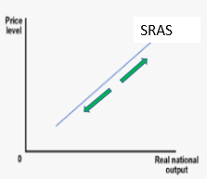
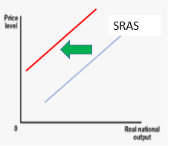
Explain the effect of each of the following on the short run aggregate supply curve:
a) An increase in the price level.
This represents an upward movement (from left to right) along the SRAS curve because changes in the aggregate price level do not shift the aggregate supply curve.
B) an increase in wages that is not matched with an increase in productivity.
The SRAS curve will shift to the left because production costs are now higher, leading to a lower output at any given aggregate price level.

Slide 55
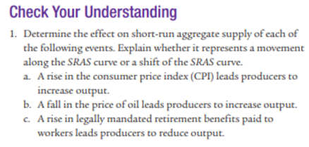
Module 18
A. movement along the curve (price level change)
B. positive supply shock (lower input cost)
C. negative supply shock (higher input cost)

Slide 56
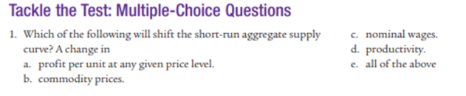
Module 18
Answer: E

Slide 57
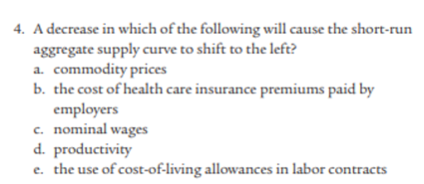
Module 18
Answer: D

Slide 58

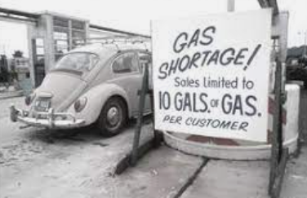


Slide 59
1970s US Oil Shortage
What is oil used for?
Answer: Just about everything!
Therefore, when there was a shortage of oil in the US, this had a negative effect on aggregate supply.
Short Run Aggregate Supply (SRAS)

Slide 60
1973 Oil Crisis – YouTube
  Timestamps:
    0.10 – intro
    1.40 – effect
    2.33 – photos from that period
    4.20 – importance of petrol

Slide 61
Movement Along
Shift of the Curve
Change in price level (the y axis)
  Movement along the same curve.
Change in other factors that affect production
  Shifts the curve left or right
  Eg. wages, material costs, productivity, weather (farming), war, disease
SRAS
SRAS

Slide 62
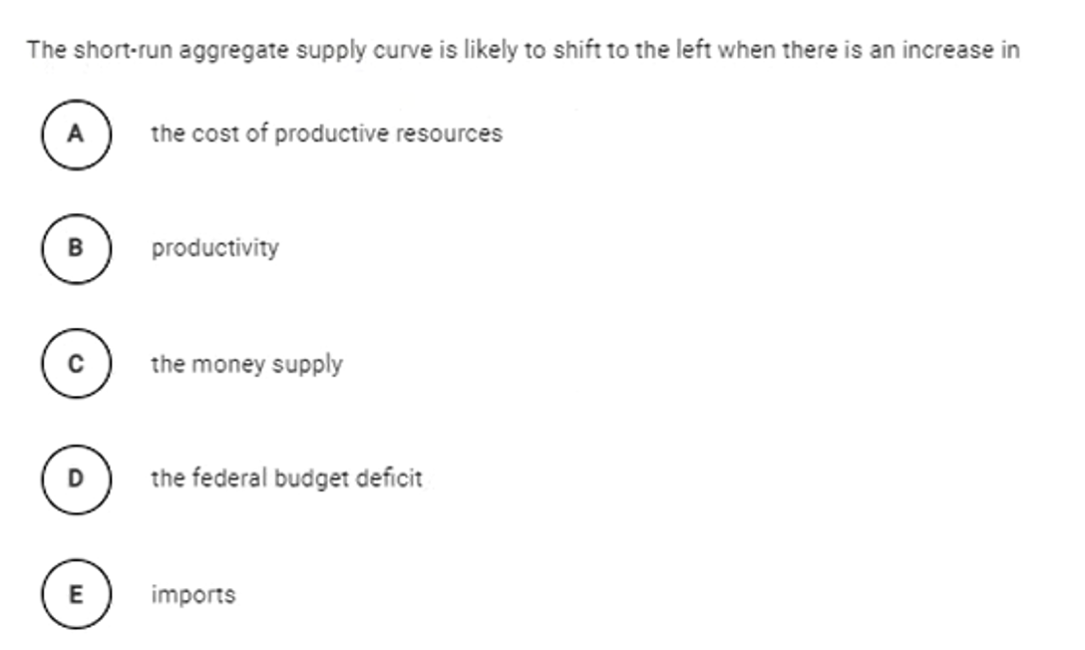
Answer: A

Slide 63
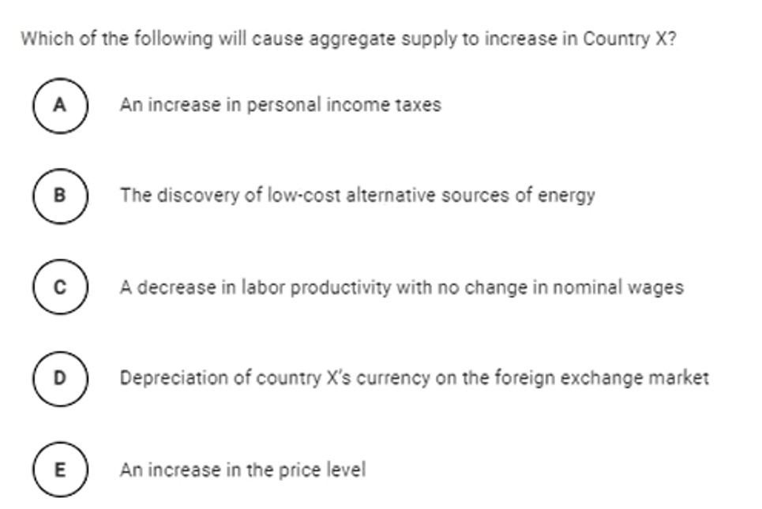
Answer: B

Slide 64
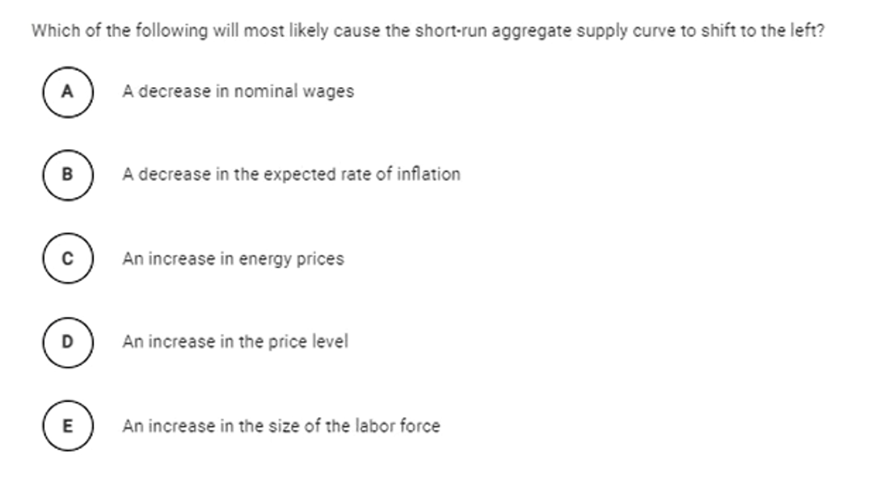
Answer: C

Slide 65
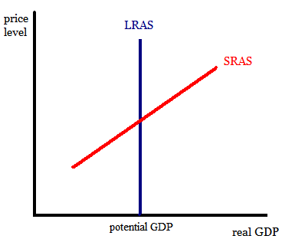
Long Run Aggregate Supply and Short Run Aggregate Supply
Summary
SRAS and LRAS look like this.
There are two types of Aggregate Supply (AS)
  Short Run Aggregate Supply Curve (SRAS)
  Long Run Aggregate Supply Curve (LRAS)
This will be a difficult concept, so I will first give you a sneak peak of what we will be constructing.
Slopes up because of sticky wages.
LRAS & SRAS

Slide 66
Long Run and Short Run

Slide 67



Long Run and Short Run
Summary
SR – some factor is fixed.
LR – less factors are fixed.
Short Run
We assume some factor is fixed.
Eg. If your restaurant has one oven, we assume you cannot buy one until the ‘next period’
Long Run
We assume no factors are fixed (or that less factors are fixed)
Eg. If you restaurant kitchen is small you can move into a new building, or renovate.

Slide 68
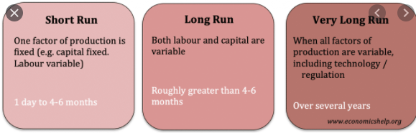
Approximate Time Periods
Episode 20B - Short Run vs. Long Run Production - YouTube

Slide 69

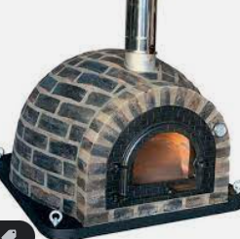

Short Run vs Long Run – Capital Example
Summary
In this case, capital equipment is fixed in the short run and variable in the long run.
Short Run
The capital equipment (eg. Oven) is fixed.
So if we want to produce more we must increase the number of employees.
Long Run
More things are variable so we assume that capital equipment is variable.
Therefore if we want to produce more, we can increase the workers but also the capital equipment because the capital equipment is also variable.
Output
Before – 100 pizzas
After – 195 pizzas
Output
Before – 100 pizzas
After – 150 pizzas

Slide 70
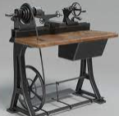

Short Run vs Long Run – Technology Example
Short Run
Eg. technology is fixed. If you want to increase your speed of production of cars, you need more machines because the technology can’t improve quickly.
Long Run
Eg. technology. If you want to increase your speed of production of cars, you can still add more machines but you can also improve technology which will increase output.

Slide 71
Long run or short run?
A car repair shop has 3 people working in the garage. They want to expand and move into a larger building so they can fit more people in the garage but this will take some time so they work longer hours instead.
Short run – we can see that in this scenario, the size of the building is ‘fixed’
A computer chip manufacturer wants to expand its production. It invests in research and development and also builds new factories and increases production.
Long run – we can see that none of the resources are ‘fixed’ because the company is able to increase its technology and the number of factories.

Slide 72
Short Run Aggregate Supply – Sticky Wages
Slopes up because of sticky wages.
LRAS & SRAS

Slide 73


SRAS vs LRAS
Summary
In the case of SRAS and LRAS. The fixed factor is the wages and resource costs.
SRAS
Wages and resource costs are relatively fixed.
Eg. There is a recession and your boss wants to lower everyone’s wages so that no one has to lose their job but is unable to so he fires some workers instead.
LRAS
Wages and resource costs are flexible/variable.
Eg. There is a recession and your boss wants to lower everyone’s wages so that no one has to lose their job.

Slide 74




Reasons for Sticky Resource Costs
Sticky Wages – MRU - YouTube
Wage changes =
Labor in particular is sticky which causes price of labor to be slow to adjust for various reasons.
  Contracts. Eg. An employee may have a contract where they are paid 15000 RMB each month that lasts for a year. Even if the price level rises (inflation), they will be locked into that contract.
  Dislike of pay cuts. Workers have an intense psychological dislike for pay cuts, even if the economic situation is poor in the country, employees don’t want to receive pay cuts.
  Efficiency wages – many businesses pay extra to keep quality workers. Therefore they find it harder to pay less because they may lose their best workers.
  All of these above factors make the wage less likely to change! Similar logic applies to the other resources.
Note: We sometimes say ‘sticky wages’ in place of ‘sticky resource costs’. Both are explaining that the prices of producer inputs are slower to adjust than other prices.
Summary
Wages and other resource costs resist change and are therefore referred to as ‘sticky’.
LRAS & SRAS

Slide 75


Sticky Resource Costs – Contract Example
Summary
Sticky resource costs, often caused by contracts
Sticky resource costs can also apply to the materials/inputs that a business buys.
10,000
$1
$1.20
->
$1.50
A soap making company sells soap to a supermarket.
They have a contract and agree to sell a certain amount of soap for a certain price. Eg. 10,000 bars of soap for $1 each
Even if the supermarket prices of soap go up eg. $1.20 ->$1.50, the supermarket will still pay the soap maker the same amount for the soap – $1 each. Even though the supermarket can sell for a higher price.
Cyclical Unemployment and Sticky Wages – YouTube (MRU video)

Slide 76
What do we mean by ‘sticky resource costs’?
It means that the prices of resources are slow to change.
What is one reason that wages are ‘sticky’?
Contracts, which lock in a certain wage for longer periods of time.
Dislike of paycuts (prevents the wage from falling).
Efficiency wages to keep quality workers (also prevents the wage from falling).

Slide 77
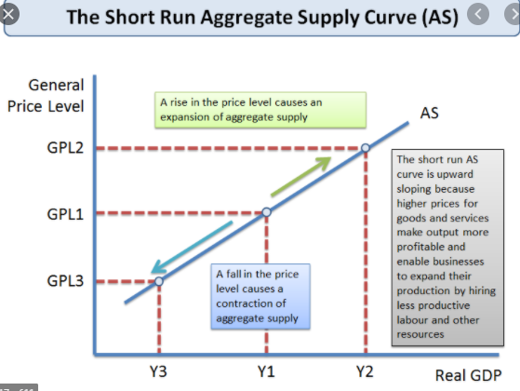
Short Run Aggregate Supply (SRAS)
Note: Sometimes the SRAS will be referred to as just AS.
We said that SRAS has relatively fixed wages and resource costs.
  ‘sticky’ = prices are slow to change
  Resource costs = costs including wages, materials, rents etc.
  We usually call this ‘sticky resource costs’ / ‘sticky wages’
SRAS slopes up because of ‘sticky resource costs’.
We will explain why.
SRAS
Summary
When it comes to the SRAS, we assume the resource costs are somewhat fixed – we refer to this as sticky.
LRAS & SRAS

Slide 78
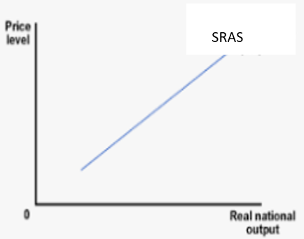
Consequence of Sticky Resource Costs
Let’s assume we have an economy where there is inflation and deflation from time to time.
If the price level changes, businesses change the price of their goods and services.
However, Sticky Resource costs cause the resource prices to stay the same.
When the Price Level Goes Up
Business Revenue = Increase
Business Resource costs = stay the same (eg. Wages, material cost etc.)
This increases business profits, so they will increase production, increasing GDP.
When the Price Level Goes Down
Business Revenue = Decrease
Business Resource costs = stay the same
This decreases business profits, so they will decrease production, decreasing GDP.
↑ price level -> ↑ output
↓ price level -> ↓ output
Summary
Sticky wages cause:
More profit and production when price level increases
Less profit and production when price level decreases.
So, there is a positive relationship between price level and output – so SRAS slopes upward.

Slide 79
As an example, what happens to profits and production when the price level decreases when we have sticky resource costs.
The price of what a business sells has decreased, but unfortunately for them, the resource costs are unchanged. Therefore businesses will make less profit and produce a lesser quantity.
What relationship exists generally between output and the price level when we look at the SRAS?
There is a positive relationship between the price level and output.
What is the main factor for this relationship?
Because of the sticky wages/sticky resource costs.

Slide 80

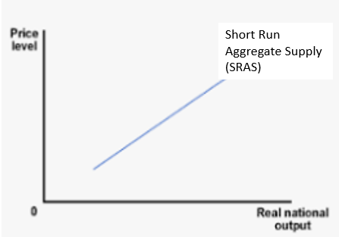
Sticky Wages Summary
Wage changes =
Price of product changes =
and
Upward sloping SRAS curve
Summary
The SRAS slopes up because of sticky wages which makes producers produce more when the price level increases (positive relationship).

Slide 81
Describe the short run aggregate supply and explain its graphical representation.
The short run aggregate supply curve shows the relationship between the aggregate price level and output.
It is upward sloping of fixed/sticky wages which don’t change when there are higher or lower prices – leading to different profits and different output.
SRAS
“SRAS slopes up because of sticky wages.”

Slide 82
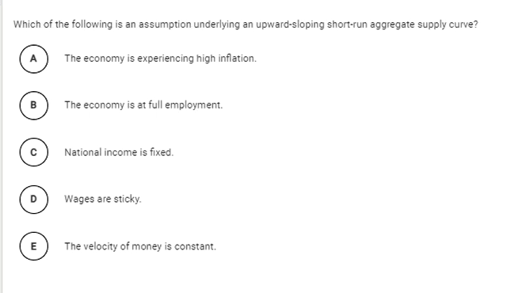
Answer: D

Slide 83
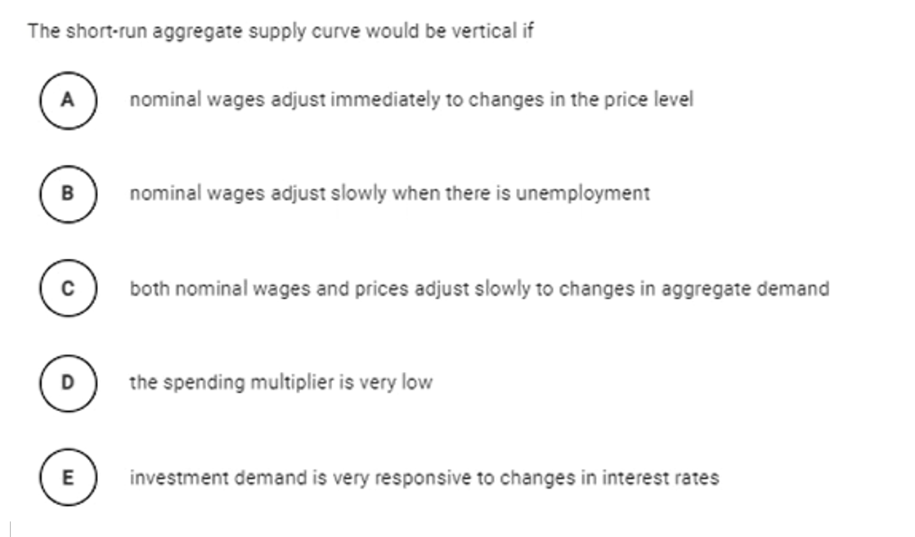
Answer: A
Because then, business would not have more or less profit when prices change. So they would produce the same amount as before.

Slide 84
Topic Review
What is the difference between long run and short run?
  Long run – less things are fixed – most if not all things are variable
  Short run – at least one factor is more fixed eg. technology, the wage rate, the amount of land
    Note: When we talk about the SRAS we are saying that the wages & resource costs are more fixed ie. Sticky.
What does SRAS stand for and why is it upward sloping?
  Slopes up because of sticky wages.
  Sticky wages – the price of wages changes slower than the price of other things, so businesses produces more when the price level goes up
With sticky wages, what is the effect on business profits and production when prices go up?
  Can sell for a higher price but pay workers the same wage → ↑profits →↑production/RGDP
With sticky wages, what is the effect on business profits and production when prices go down?
  Must sell for lower price, but pay workers the same →↓profits →↓production/RGDP

Slide 85
SRAS (Short Run Aggregate Supply)
LRAS (Long Run Aggregate Supply)
Upward slope
sticky wages / sticky resource costs
Vertical
No sticky wages.
LRAS
SRAS
Businesses: “If the price level goes up, I can increase my prices, but now I have to also pay my workers more. So my profits are the same.”
Businesses: “If the price level goes up, I can increase my prices, but pay my workers the same. So my profits increase!”

Slide 86
Long Run Aggregate Supply - LRAS
LRAS & SRAS

Slide 87


Long Run Aggregate Supply (LRAS)
The Long-Run Aggregate Supply Curve – MRU- YouTube
  What factors determine the long run production capability of the economy?
  In short, the level of technology, capital and quality of quantity of resources determines the long term production.
  Long Run Aggregate Supply (LRAS) represents the long run production.
  Because it is the long run, all variables will have time to change and so there are NO STICKY RESOURCE COSTS ie. FLEXIBLE.
  Because resource costs will adjust quickly at the same speed as goods and services, there will be no relationship between price level and output.
LRAS
The LRAS is vertical, showing no relationship between price level and output.
Summary
LRAS has no relationship between price level and output unlike SRAS.
LRAS – determined by long term resources and technology
LRAS & SRAS

Slide 88
What does LRAS stand for?
Long Run Aggregate Supply
What does LRAS show?
It shows the economy’s long run ability to produce, which is determined by the resources (land, labor, capital, enterprise) and technology
What does the completely vertical long run supply curve say about price level and production?
Long run production is only affected by the factors of production and technology. So price level/inflation has NO EFFECT on our ability to produce.
LRAS & SRAS

Slide 89

Graphing the LRAS
Note: because there are no sticky wages, the price level won’t affect how much we produce at all because the price of wages will change as well, so business profits will not change with price level.
The LRAS is vertical because the price level doesn’t matter in the long run.
  The only thing that matters in production is the technology and resources of the economy.
The output level is called Y_{P} or Potential Output. This is the happy, sustainable level of output that occurs when there is no recession or short term expansion in the economy.
Y_{p} = potential output = Y_{f} = full employment
Summary
No relationship between price level and output – vertical LRAS
Y_{P} = Y_{f} = Potential Output = the happy level (Note: Never write ‘happy level’ on an official exam.

Slide 90

Potential Output and the Business Cycle
Potential Output Y_{P} can be showed as the LRAS or on the business cycle. We can also call this Y_{f} which is full employment/full employment output.
It represents the long run, sustainable level of output.
  This level will increase as we have increases in technology, population, education etc.

Slide 91

Factors that shift the LRAS
Things that decrease production costs or increase the quantity that we can produce will shift the LRAS right.
  A rightward shift in LRAS represents economic growth!
However, they should be based on long term or even permanent, structural changes to the economy.
  Eg. An earthquake may temporarily shut down a city but it will not cause a long term reduction in production.
  Question: Are the wildfires in Australia part of a short term or long term phenomena? (Link)
Summary
The LRAS will shift when only permanent, long term changes occur in the economy.
LRAS & SRAS

Slide 92





Technology, LRAS and RGDP
LRAS₀
LRAS₁
LRAS₂
LRAS₃
LRAS₄
Y_{P0}
Y_{P1}
Y_{P2}
Y_{P3}
Y_{P4}
Each time we improve our technology, our ability to produce increases. An important invention such as the light bulb or the computer will increase our productivity a lot which means a rightward shift of the LRAS.
When we shift the LRAS to the right, this means our Potential Output (Y_{P}) increases. This is responsible for the increase in economic growth.

Slide 93

Long Run Aggregate Supply Shocks
Supply shocks shift the supply left or right.
Factor | Increase | Decrease
Technology | ↑LRAS, Y_{P} | ↓LRAS, Y_{P}
Education of Workers | ↑LRAS, Y_{P} | ↓LRAS, Y_{P}
Number of machines | ↑LRAS, Y_{P} | ↓LRAS, Y_{P}
Population increase | ↑LRAS, Y_{P} | ↓LRAS, Y_{P}
Discovery of new resources | ↑LRAS, Y_{P} | ↓LRAS, Y_{P}
Climate Change | ↓LRAS, Y_{P} | ↑LRAS, Y_{P}
Long term change to corporate tax | ↓LRAS, Y_{P} | ↑LRAS, Y_{P}
Aging Population | ↓LRAS, Y_{P} | ↑LRAS, Y_{P}

Slide 94
Long Run Aggregate Supply Shocks
Supply shocks shift the supply left or right.
Factor | Increase | Decrease
Technology | ↑LRAS, Y_{P} | ↓LRAS, Y_{P}
Education of Workers | ↑LRAS, Y_{P} | ↓LRAS, Y_{P}
Number of machines | ↑LRAS, Y_{P} | ↓LRAS, Y_{P}
Population increase | ↑LRAS, Y_{P} | ↓LRAS, Y_{P}
Discovery of new resources | ↑LRAS, Y_{P} | ↓LRAS, Y_{P}
Climate Change | ↓LRAS, Y_{P} | ↑LRAS, Y_{P}
Long term change to corporate tax | ↓LRAS, Y_{P} | ↑LRAS, Y_{P}
Aging Population | ↓LRAS, Y_{P} | ↑LRAS, Y_{P}

Slide 95

Change in SRAS and LRAS
Summary
Long term factors shift BOTH the SRAS and LRAS.
Short term factors shift only the SRAS.
A change in short run supply factors which are not permanent will change the SRAS only but not LRAS.
A change in long run, permanent factors will change BOTH the SRAS and the LRAS.
Eg. An earthquake causes a decrease in production for a few weeks.
Eg. Education reforms cause large parts of the population to have improved knowledge and skills.
The SRAS will shift to the left, as production is reduced.
LRAS will be unchanged because the situation will soon be resolved.
Both the LRAS and SRAS will increase.

Slide 96
Would a temporary decrease in trade caused by bad weather shift the LRAS, SRAS or both?
SRAS only because it is short term.
Would the construction of a railway network across a country shift the LRAS, SRAS or both?
Both, because a long run change shifts LRAS but also SRAS.

Slide 97





Suez Canal Blockage
Suez Canal – increased the LRAS of many countries because of more efficient trade routes.
Blockage of the Suez Canal – decreased the SRAS because of the temporary blockage caused by a ship that became stuck!

Slide 98




Economic Growth
Economic Growth = Increase of LRAS
Economic growth means that real GDP is increasing year on year. This means that the economy can produce more.
It means an increase in Potential Output, Y_{P} represents the long run sustainable level of output based on the resources and technology. It is linked to the LRAS.
Summary
Economic Growth
= rightward shift of LRAS
= rightward shift of PPC
= increase in GDP
Quantity and quality of capital: An increase in capital goods and other forms of investment allows for the production of additional output. As a result, LRAS shifts to the right, and potential output increases. Investments in technology and equipment also increase productivity and shift the LRAS curve to the right.

Slide 99
Graphically, how can we represent economic growth?
We can show a rightward shift of Y_{P} and the LRAS.
We can show a rightward shift of the PPC.
We can also show GDP increasing year on year.

Slide 100

AP Exam Question
Answer: D
Economic growth is an increase in the LRAS and Y_{P} (Potential Output)

Slide 101
DO Module 18 Questions

Slide 102

The change could be caused by:
  Price level change (movement along the SRAS)
  Long term factors (shift the LRAS)
  Short term factors (shift the SRAS)
All of these would increase output but we don’t know which.

Slide 103

Answer: A
No sticky wages. Wages are flexible.
Answer: D
Answer: C.
Potential Output
Answer: E
They change slowly.

Slide 104



c) Increase in wages, increase in commodity costs, decrease in capital, decrease in technology
d) Technology, education, productivity, capital employed
Note: Long Term factors shift the SRAS as well.
But only long term factors shift the LRAS.

Slide 105



AD, SRAS, LRAS
AD, Aggregate Demand – demand for all goods and services in the economy (Equal to C+I+G+(X-M))
AS, Aggregate Supply – production function of all goods and services in the economy
  SRAS, Short Run Aggregate Supply – production function of all goods and services in the economy in the short run
    Slopes up as a result of sticky wages (price of labor is fixed in the short run)
  LRAS, Long Run Aggregate Supply – production function of all goods and services in the economy in the long run
    This represents the long run productive capacity of the economy
      Things such as technology level, education level, government stability etc. are important for LRAS

Slide 106
Aggregate Demand and Supply Shocks Summary

Slide 107
Demand Shocks – What will be the effect on AD?
Factor | Increase | Decrease
Stock market stocks owned by households | ↑AD – consumers are wealthier now | ↓AD – consumers are poorer now
Government purchases | ↑AD – increase government spending | ↓AD – decrease gov spending
Consumer Confidence | ↑AD – consumers will buy more in the future | ↓AD – consumers will buy less
Unemployment | ↓AD – people have less income | ↑AD – people have more income
Technology of Products | ↑AD – consumers are attracted by new products | ↓AD – consumers get less utility from products
Inventory levels and Capital Goods levels | ↓AD – businesses don’t need to invest as much in new inventory | ↑AD – businesses need to buy a lot of new inventory
Price level of another country | ↑AD – foreigners will purchase more of our exports | ↓AD – foreigners will purchase less of our exports

Slide 108
Factors that shift the SRAS Curve
Factor | Increase | Decrease
Commodity Cost | SRAS shifts to the left | SRAS shifts to the right
Nominal Wages | SRAS shifts to the left | SRAS shifts to the right
Productivity | SRAS shifts to the right | SRAS shifts to the left
Price of imported raw materials | SRAS shifts to the left | SRAS shifts to the right
Negative weather events (drought, earthquakes etc.) | SRAS shifts to the left | SRAS shifts to the right
Corporate Taxes | SRAS shifts to the left | SRAS shifts to the right
Education Levels | SRAS shifts to the right | SRAS shifts to the left
Inflationary Expectations | Decrease SRAS (workers ask for higher wages) | Increase SRAS (business owners will lower people’s wages)

Slide 109
Long Run Aggregate Supply Shocks
Supply shocks shift the supply left or right.
Factor | Increase | Decrease
Technology | ↑LRAS, Y_{P} | ↓LRAS, Y_{P}
Education of Workers | ↑LRAS, Y_{P} | ↓LRAS, Y_{P}
Number of machines | ↑LRAS, Y_{P} | ↓LRAS, Y_{P}
Population increase | ↑LRAS, Y_{P} | ↓LRAS, Y_{P}
Discovery of new resources | ↑LRAS, Y_{P} | ↓LRAS, Y_{P}
Climate Change | ↓LRAS, Y_{P} | ↑LRAS, Y_{P}
Long term change to corporate tax | ↓LRAS, Y_{P} | ↑LRAS, Y_{P}
Aging Population | ↓LRAS, Y_{P} | ↑LRAS, Y_{P}

Slide 110
AD/AS Equilibrium

Slide 111

Long Run Equilibrium
This is the default, sustainable equilibrium of the economy.
At this point we can see that AD, SRAS and LRAS all intersect at the same point.
At this level of output, the real GDP is called Potential Output or Yp.
  This means that the economy is operating at a good, sustainable level.
  It therefore corresponds to the natural rate of unemployment, NRU (=structural + frictional unemployment)
At Yp/Yf we have the NRU – Natural Rate of Unemployment.

Slide 112
Draw the AD/AS Graph long run equilibrium. Label all the axes, all the curves correctly.

Slide 113



What information is contained in the AD/AS Graph?
Summary
We can observe the key economic indicators in this AD/AS graph.
What were the three main economic indicators from Unit 2?
  GDP - Economic Growth (x axis)
  Unemployment (implicitly shown on the x axis)
  Price Level/inflation (y axis)
We can label the y axis:
Price Level
PL (price level)
Inflation (much less common because inflation is change in price level so slightly different)
Note: We can also label the x axis:
RGDP
GDP
Y
Output
Income (not common)
Unemployment isn’t explicitly shown on the graph, however with higher output, ceteris paribus, we will have more employment.
At Yp we have the NRU – Natural Rate of Unemployment.

Slide 114
Potential Output and the Business Cycle
Potential Output Y_{P} (also called Full Employment Output, Y_{F} ) can be showed as the LRAS or on the business cycle.
It represents the long run, sustainable level of output.
  This level will increase as we have increases in technology, population, education etc.

Slide 115
What unemployment level do we have when we produce below Y_{P}?
At the Y_{P} we have the NRU.
Below Y_{P} we have cyclical unemployment.
Actual Unemployment > NRU
If the price level rises on the AD/AS graph, does this show inflation or deflation?
Inflation

Slide 116
Changes in AD/AS Equilibrium

Slide 117


Changes to AD/AS Equilibrium
Just like we made changes to supply and demand with our microeconomics curves, we can do the same for the AD/AS curve.
These changes will have an effect on the Price Level and the Real Output.
These changes can be caused by either a change in AD, SRAS or LRAS.
↓AD→ ↓PL, ↓Y
↑AD→ ↑PL, ↑Y
What effect would a change in SRAS have?
Summary
Changes in AD, SRAS or LRAS change the equilibrium.
The Price Level and Output will change.

Slide 118

Draw the effect of a decrease in the SRAS.
What might have cause this shift?
Eg. Increase in oil prices, increase in wages, natural disaster.
What happens to the price level?
Increases. (inflation)
What happens to output?
Decreases.

Slide 119
What happens to the price level when AD increases (moves right)?
Price level increases (inflation).
What happens to the price level when the LRAS increases (moves right)?
Price level decreases. Deflation. However, this is viewed as a good kind of deflation.
(Eg. Nowadays almost everyone can afford a smartphone where as in the past, only a small number of people could.)

Slide 120

Long Run vs Short Run Equilibrium
Summary
There is only one long run equilibrium: AD = SRAS = LRAS, Output = Y_{p}
Other equilibriums are short run equilibriums.
We will examine this in more detail, however we should be able to identify, which of the 3 equilibriums are long run or short run.
Can you guess?
Y_{P} level of production is the long run equilibrium. When we are not producing at Y_{p} we are in a short run equilibrium.
3
1
Potential Output Level
2
Short Run Equilibrium
Short Run Equilibrium
Long Run Equilibrium
Short Run Equilibrium
AD = SRAS
But not LRAS
Short Run Equilibrium
AD = SRAS
But not LRAS
Long Run Equilibrium
AD = SRAS = LRAS

Slide 121
Activity: Draw a short run equilibrium in the AD/AS graph.
Note that AD = SRAS =/= LRAS
Draw a long run equilibrium in the AD/AS graph.
Note that AD = SRAS = LRAS

Slide 122

Output Gaps Revision
Potential output represents the output when the economy is at it’s ‘happy level’ and is a theoretical level.
Actual output is the level of production we see in the real world which often is different from the potential output.
We call the difference between Actual Output and Potential Output an output gap.
positive
negative
The difference between Actual and Potential output is called an output gap!
The economy is therefore in three states:
  Potential Output (happy level where Actual Output = Potential output)
  Positive Output Gap (producing at a higher but not sustainable level)
  Negative Output Gap (the economy is underperforming)
Output gap = Actual Output – Potential Output
Summary
The economy can be in a positive output gap, negative output gap or at potential output.

Slide 123

What is the size of the output gap of an economy with potential output of 15 trillion and actual output of 13 trillion. What kind of output gap is this?
Output gap = Actual – Potential = 13-15 = -2 trillion
This would be a negative output gap.
Label the points A, B and C as output gaps.
A – Positive Output Gap
B – Potential Output (no output gap)
C – Negative Output Gap

Slide 124
Negative and Positive Output Gaps
Negative Output Gap
Actual Output < Potential Output
Recessionary Gap (because we are producing less than Y_{p} )
Potential Output
Actual Output = Potential Output
Full Employment (because we are at the NRU)
Positive Output Gap
Actual Output > Potential Output
Inflationary Gap (because the price level will increase because AD is higher.
3
1
Potential Output Level
2
Short Run Equilibrium
Short Run Equilibrium
Long Run Equilibrium
Short Run Equilibrium
AD = SRAS
But not LRAS
Short Run Equilibrium
AD = SRAS
But not LRAS
Long Run Equilibrium
AD = SRAS = LRAS
Y_{actual}
Y_{actual}

Slide 125



Draw three AD/AS equilibrium on three separate graphs.
Negative Output Gap, Potential Output, Positive Output Gap

Slide 126
What are three situations an economy can be in? Hint: 1. P______ Ou______ 2. N______ Ou________ G___ 3. Pos______ Ou________ G___
Potential Output (Y_{p}) – nice, happy level of output, when the economy is at a sustainable level with good growth and low unemployment
Negative Output Gap – Output < Potential Output ie. A period of lower economic activity such as a recession
Positive Output Gap – Output > Potential Output ie. A period where we are producing above the long term sustainable level. The ‘engine will start to overheat’.

Slide 127
A recessionary gap is a positive or negative output gap?
Negative, because the economy is producing less than usual (< Y_{p})
An inflationary gap is a positive or negative output gap?
Positive output gap, because the economy is producing more than usual and the price level is higher.

Slide 128
Equilibrium Questions - Handouts
400Q
Module 19
APQB

Slide 129
Typical AP Free Response Question
Include correctly labeled diagrams, if useful or required, in explaining your answers. A correctly labeled diagram must have all axes and curves clearly labeled and must show directional changes.
The economy of Country X is at full employment.
Draw a correctly labeled graph of the long-run aggregate supply, short-run aggregate supply, and aggregate demand curves, and show each of the following. (i) Current price level, labeled (ii) Current real output, labeled
Assume that household income increases as a result of recent economic prosperity in Country X. On your graph in part (a), show the effect of the increase in household income on real output and price level.
What will be the effect of the change identified in part (b) on unemployment in Country X?

Slide 130
Summary – AD, SRAS, LRAS, Equilibrium

Slide 131
AD, SRAS, LRAS
AD, Aggregate Demand – demand for all goods and services in the economy (Equal to C+I+G+(X-M))
AS, Aggregate Supply – production function of all goods and services in the economy
  SRAS, Short Run Aggregate Supply – production function of all goods and services in the economy in the short run
    Slopes up as a result of sticky wages (price of labor is fixed in the short run)
  LRAS, Long Run Aggregate Supply – production function of all goods and services in the economy in the long run
    This represents the long run productive capacity of the economy
      Things such as technology level, education level, government stability etc. are important for LRAS

Slide 132
What information is contained in the AD/AS Graph?
Summary
We can observe the key economic indicators in this AD/AS graph.
What were the three main economic indicators from Unit 2?
  GDP - Economic Growth (x axis)
  Unemployment (implicitly shown on the x axis)
  Price Level/inflation (y axis)
We can label the y axis:
Price Level
PL (price level)
Inflation (much less common because inflation is change in price level so slightly different)
Note: We can also label the x axis:
RGDP
GDP
Y
Output
Income (not common)
Unemployment isn’t explicitly shown on the graph, however with higher output, ceteris paribus, we will have more employment.
At Yp we have the NRU – Natural Rate of Unemployment.

Slide 133
Long Run vs Short Run Equilibrium
We will examine this in more detail, however we should be able to identify, which of the 3 equilibriums are long run or short run.
Can you guess?
We can see that the Y_{P} level of production is the long run equilibrium. We will later find out why this is true.
3
1
Potential Output Level
2
Short Run Equilibrium
Short Run Equilibrium
Long Run Equilibrium
Short Run Equilibrium
AD = SRAS
But not LRAS
Short Run Equilibrium
AD = SRAS
But not LRAS
Long Run Equilibrium
AD = SRAS = LRAS
Y_{actual}
Y_{actual}

Slide 134
Negative and Positive Output Gaps
Negative Output Gap
Actual Output < Potential Output
Recessionary Gap (because we are producing less than Y_{p} )
Potential Output
Actual Output = Potential Output
Full Employment (because we are at the NRU)
Positive Output Gap
Actual Output > Potential Output
Inflationary Gap (because the price level will increase because AD is higher.
3
1
Potential Output Level
2
Short Run Equilibrium
Short Run Equilibrium
Long Run Equilibrium
Short Run Equilibrium
AD = SRAS
But not LRAS
Short Run Equilibrium
AD = SRAS
But not LRAS
Long Run Equilibrium
AD = SRAS = LRAS
Y_{actual}
Y_{actual}

Slide 135
Appendix

Slide 136

Demand
How much people want to buy something.
So at a certain equilibrium price, people will some quantity.
If D increases, then the amount that people want to buy increases.
Aggregate Demand

